Slide 1


APM INSURANCE
Home
About Us
Services
Contact
RISK FACTORS FOR OCEAN ACTIVITIES
COMPANY: APM INSURANCE
DEPARTMENT : DATA & ANALYTICS
TEAM: ANNA, PAULINA , MARISA

Slide 2

APM INSURANCE
Home
About Us
Services
Contact
APM INSURANCE
worldwide insurance provider for EU citizens
Services provided
  full coverage tourist insurance
  watersports insurance
  ocean activity insurance
  risk assessment

Slide 3

APM INSURANCE
Home
About Us
Services
Contact
Risk Assessment for Ocean Activities
Business problem
Adjust policy pricing & coverage based on the risk associated with specific ocean activities

Slide 4

APM INSURANCE
Home
About Us
Services
Contact
Data source & Analysis overview
Source: Global Shark Attack file from Shark Research Institutes
Filteres for the last 50 years, as climate change impacts sharks activity
Data used for policy optimization: demographics, water activities, regions, and seasons

Slide 5
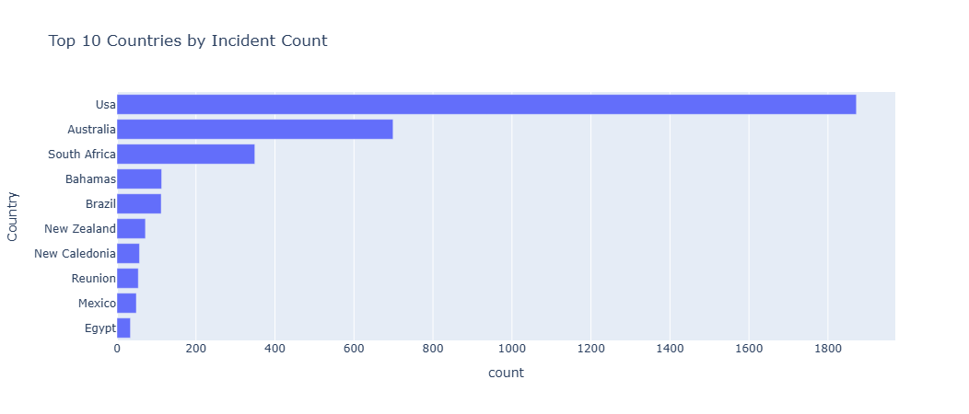
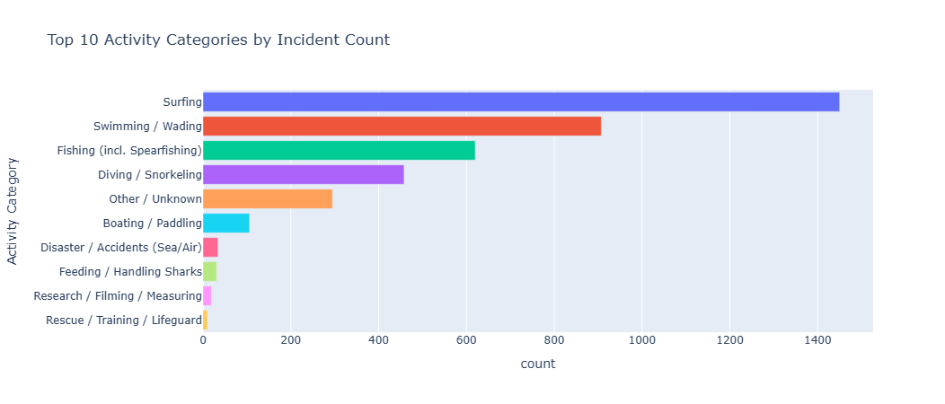
COUNTRIES
Defined 10 countries with the highest frequency of shark attack to refine the higher insurance premium
  USA
  Australia
  South Africa
  Bahamas
  Brazil
  New Zealand
  New Caledonia
  Reunion
  Mexico
  Egypt
ACTIVITY CATEGORIES
Same as the data above, we analised the 5 top risky activities to define the premium insurance increase:
  Surfing
  Swimming
  Fishing
  Diving
  Boating

Slide 6
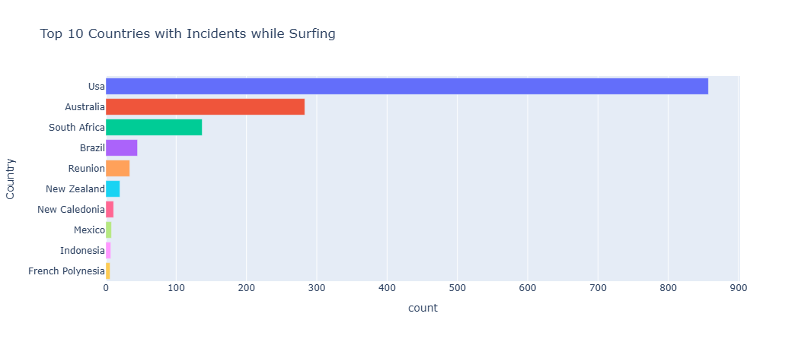
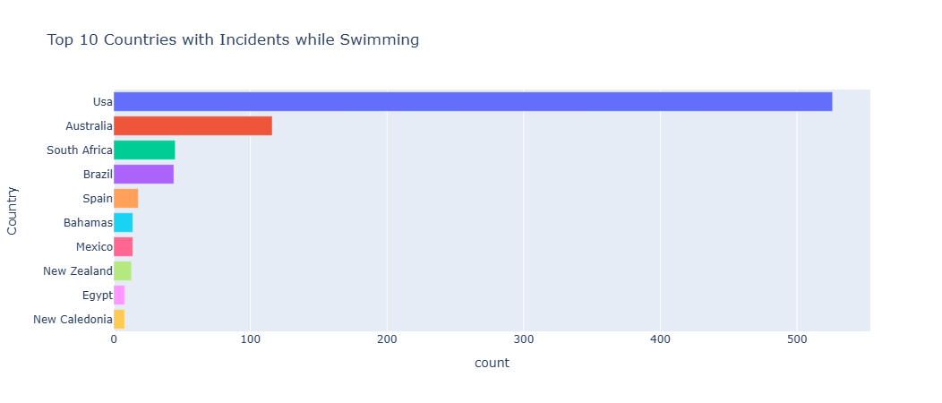
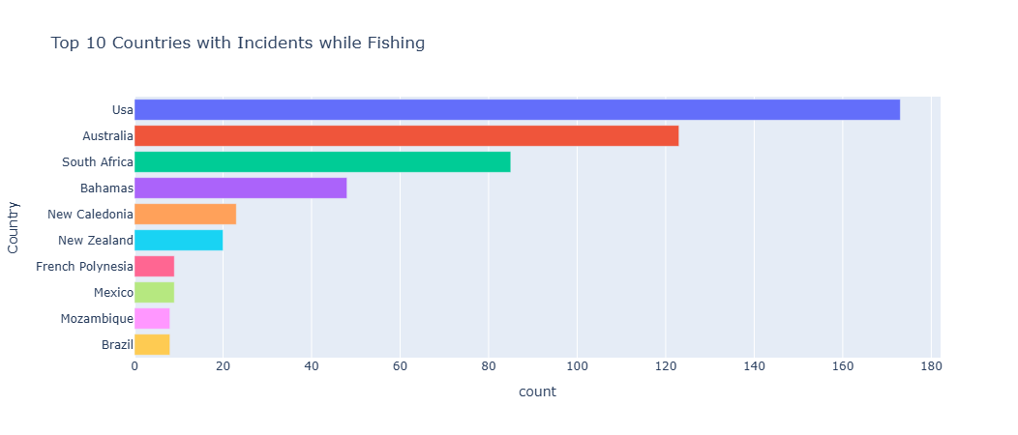
ACTIVITY PER COUNTRY
5 countries with the highest number of attacks
  USA
  Australia
  South Africa
  Bahamas
  Brazil

Slide 7
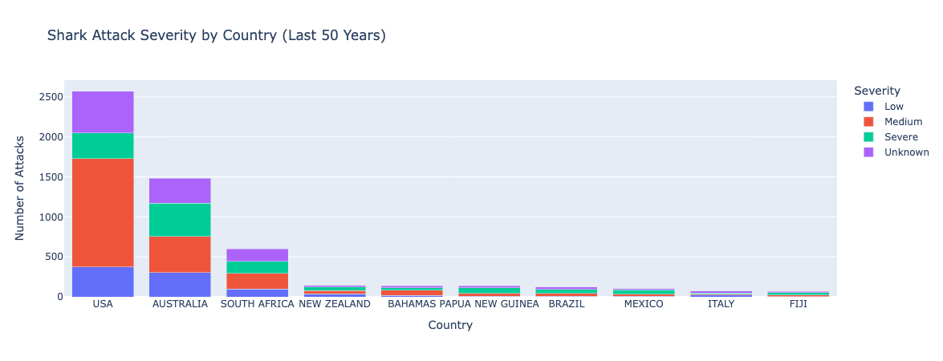
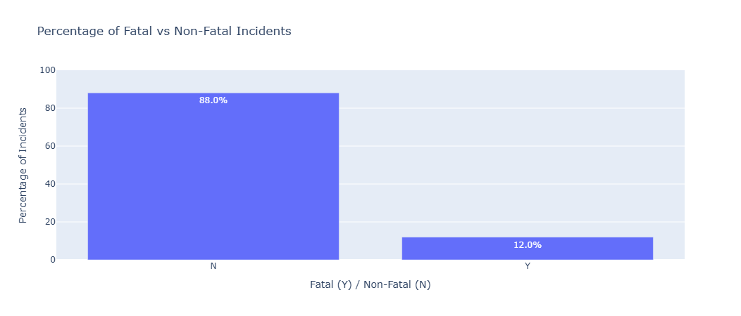
SEVERITY
The medium severity prevails in the analysis which can refine the insurance premium
FATALITY
The non fatal incidents prevail which makes it irrelevant factor for the risk assessment

Slide 8
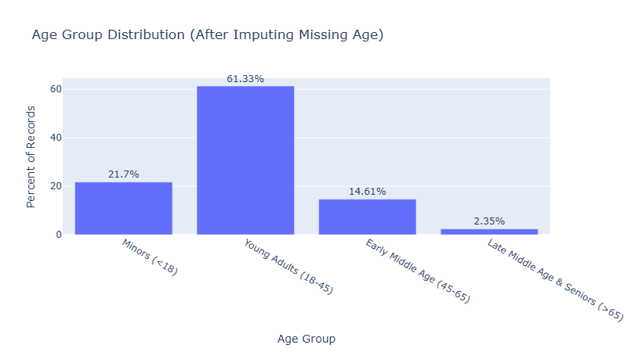
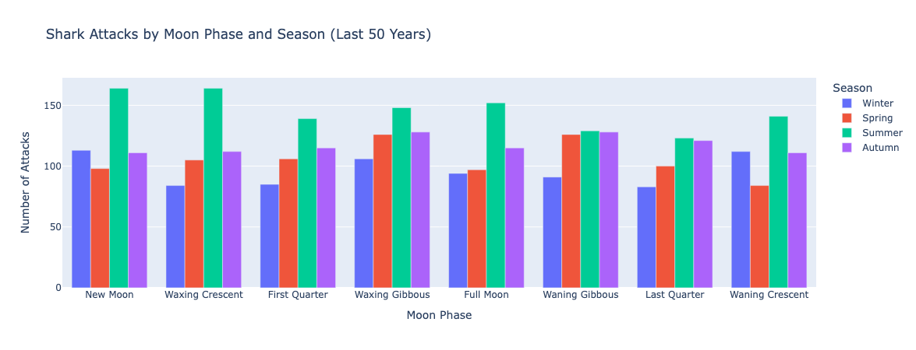
AGE
Young adults group shows the highest risk category with 61%
MOON PHASES AND SEASONS
Summer season imposes the most risk and moon fases don't show much influence in the shark behaviours

Slide 9
ANALYSIS CONCLUSIONS
BASED ON THE ANALYSIS
The analysis revealed the key factors that most strongly increase shark-attack risk, and therefore have a direct impact on insurance premium princing:
Since these factores directly influence the probability of an incident, the insurance premium should adjust accordingly:
  Country: higher premiums in high-risk regions
  Activity: surfing, diving, or other high-risk activities increase premiums
  Season: travel insurance during summer is priced higher
  Age: customers aged 18-45 face higher premiums
  10 high-risk countries
  5 high-risk activity categories
  Summer season
  Ages 18-45
CONCLUSIONS
RECOMMENDATIONS

Slide 10
APM INSURANCE
Home
About Us
Services
Contact
RISK FACTORS FOR OCEAN ACTIVITIES
THANK YOU
COMPANY: APM INSURANCE
DEPARTMENT : DATA ANALYTICS
TEAM: ANNA, PAULINA , MARISA

